Slide 1
DeepCRISTL: deep transfer learning to predict CRISPR/Cas9 functional and endogenous on-target editing efficiency
Shai Elkayam and Yaron Orenstein

Slide 2
CRISPR/Cas9
Clustered Regularly Interspaced Short Palindromic Repeats (CRISPR)
CRISPR is a family of DNA sequences found in prokaryotes such as bacteria and archaea. They are comprised of sequences of DNA (“spacers”) from past invading bacteriophages that previously attacked the prokaryote, and are are part of the prokaryote’s immune system.
These DNA sequences are used to both identify and destroy sequences of invasive DNA. Cas9 is an enzyme that actually edits the DNA of the prokaryote. It uses the CRISPR DNA sequences as a guide to know what parts of the organism’s DNA needs to be edited.
CRISPR spacer sequences are transcribed into RNA (crRNA) sequences to search for matching DNA. Once a match is found, Cas9 binds to and cuts the DNA at that point.

Slide 3
CRISPR/Cas9 (Cont.)
Spacers are added at the beginning of a CRISPR locus, and with repeat sequences between them.
Protospacer Adjacent Motifs (PAM) are 3-5 base pair DNA sequences used by CRISPR arrays as starting locations, and signal the start of DNA to copy in CRISPR loci or to edit. The end of the DNA is cut according to a ruler mechanism, so all spacers are the same length.
CRISPR-RNA (crRNA) is formed from CRISPR loci, which starts as a single RNA strand of the entire loci then split into individual spacer crRNA sequences. There are partial repeat sequences on either end of a crRNA, which prevent DNA editing beyond the spacer sequence.

Slide 4
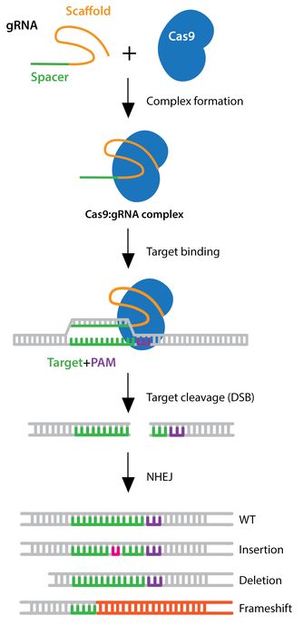
CRISPR/Cas9 (Cont.)
Modified Cas9 can be used to activate gene expression instead of cutting it, and even insert new DNA.
Giving the CRISPR/Cas9 system specifically-selected guide RNA (gRNA) allows for targeted gene editing by humans.

Slide 5
CRISPR/Cas9 Experimentation Concerns
The on-target efficiency represents how likely CRISPR/Cas9 is to edit at an off-target site. Knowing where the off-target sites are and what the on-target efficiency is for a gRNA strand is crucial for gene editing experiments.
High-throughput datasets are collected and measured in a synthetic environment, leading to low correlation with functional and endogenous editing.
Functional datasets are created by observing gene editing by-products, and using those as measurements. Endogenous datasets come from experiments that produce the most biologically relevant data. An experiment per gRNA is necessary to produce measurements.
Functional and endogenous datasets are small due to the difficulty of collecting data.

Slide 6
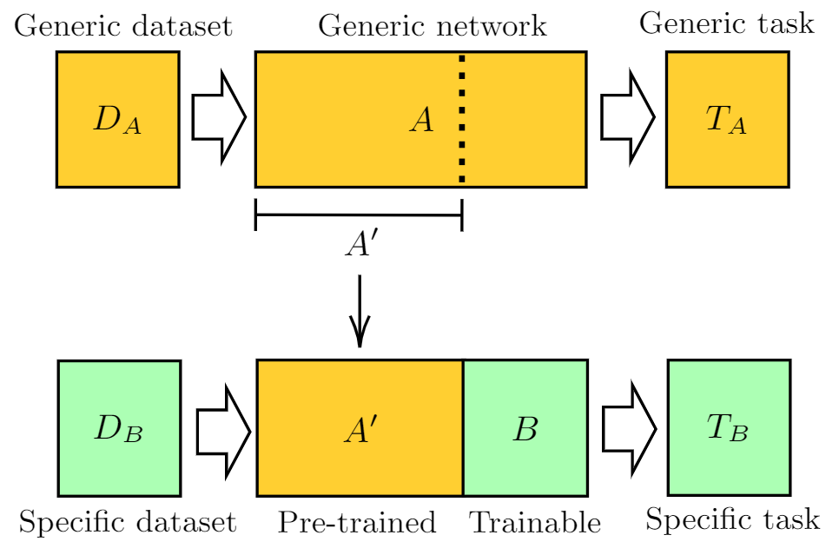
Transfer Learning
Transfer learning is a type of fine-tuning where instead of re-training the entire model, only some layers are updated.
The source dataset is the pre-training dataset. The target dataset is the fine-tuning dataset. The target set does not have to share label counts or values. The source and target sets do need to be correlated.

Slide 7
Data - Source
DeepHF is the model this work expands on. The dataset used is also referred to as DeepHF. This dataset is used as the source dataset.
The DeepHF dataset contains the targeting efficiencies of 3 enzymes; wild-type SpCas9, eSpCas9 and SpCas9-HF1 (denoted as WT, Esp and HF, respectively). Each gRNA sequence with enzyme counts over 100 were kept.
Counts:
WT: 55,604
Esp: 58,167
HF: 56,888
Total: 170,659
The CRISPROn dataset contains two sub-datasets: one of 10,592 gRNAs and the other of 13,354 gRNAs.

Slide 8
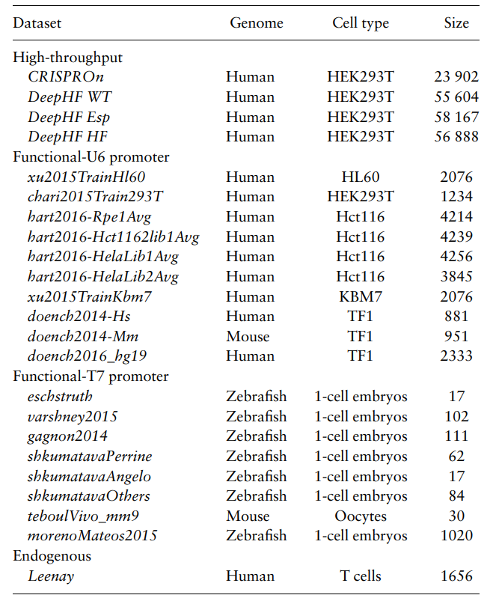
Data - Target
Functional: Datasets curated by Haeussler et al. (2016) were used. This set includes 18 functional datasets.
Endogenous: The data produced by Leenay et al. (2019). This dataset contains on-target efficiencies of 1656 gRNAs.

Slide 9
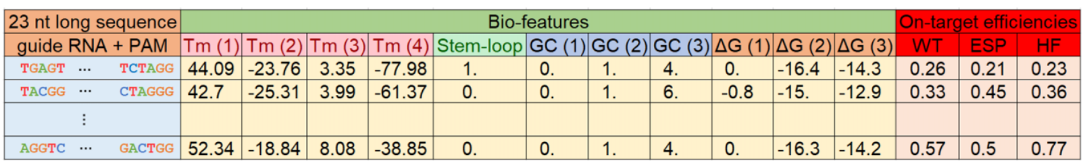
Data - Biofeatures
The DeepHF project included biofeatures in the model inputs. Results showed increased Spearman correlation, so DeepCRISTL included these features as well.
The 11 biofeatures include:
Three features of the position accessibility of the secondary structure
One feature of the stem-loop of the secondary structure
Four features of the melting temperature
Three features of the GC-content information

Slide 10
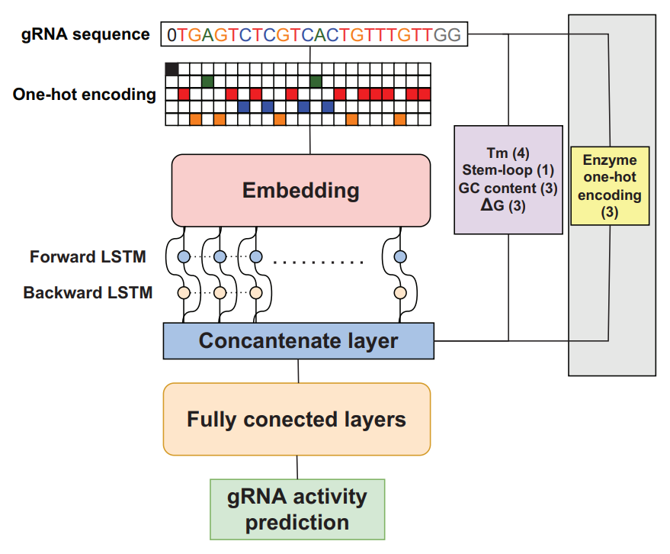
Model Architecture
DeepHF: gRNA is fed to an embedding layer, followed by a biLSTM. The output of this is concatenated with the bio-features and a one-hot encoding of which enzyme each biofeature sample is for. This is fed to multiple dense layers before prediction.
DeepCRISTL applies one-hot encoding to the gRNA before embedding, but otherwise mimics the DeepHF model.
Each model is an ensemble of 10 random initializations of the above architecture.

Slide 11
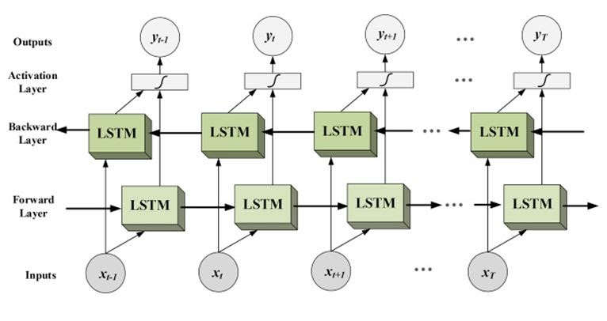

Bidirectional Long Short-Term Memory (biLSTM)
Recurrent Neural Networks (RNNs) are ML units meant to handle sequence problems, typically time series problems.
Long Short-Term Memory (LSTM) units are a kind of RNN that contain a memory unit to help minimize the vanishing and exploding gradient problems and allow for long-term dependencies.
Bidirectional LSTM (biLSTM) are LSTM networks that train both forward and backwards in time.

Slide 12
Training - Source Pre-Training
The source sets were randomly split in an 85/15 train/test split, with the caveat that all test data must have on-target efficiencies for all 3 enzymes. 10% of the training data (8.5% overall) is taken as validation data.
Random hyperparameter search for: initial learning rate, batch size, optimizer, activation function of last layer, initialization weights, embedding dimensions, dropout of embedding LSTM and dense layers, and number of dense and LSTM layers.
Early stopping was done to avoid overfitting

Slide 13
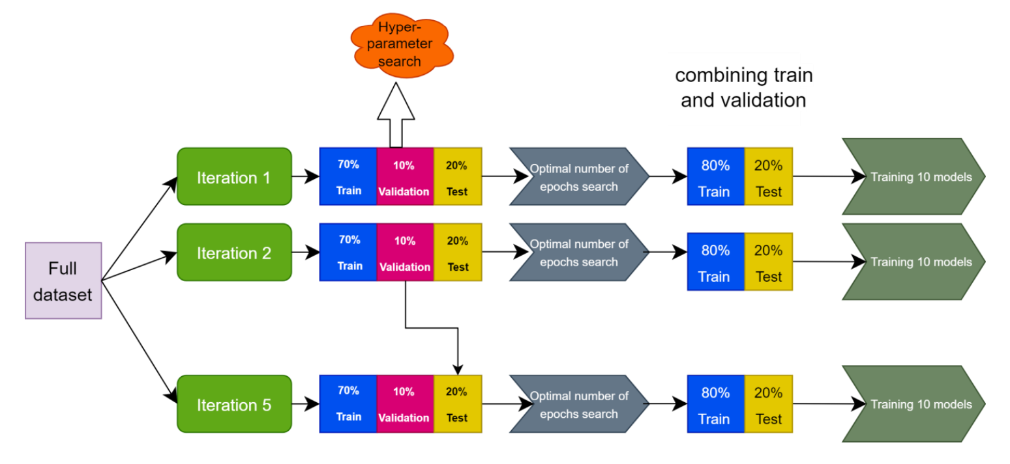
Training - Target Fine-Tuning
To get a robust evaluation, the evaluation procedure was repeated five times, each time using a different partition to training and test sets. The average and standard deviation of obtained Spearman correlations.
Each iteration had an 80/20 train/test split, with 10-fold cross-validation done to find the optimal number of training epochs.

Slide 14
Training - Target Fine-Tuning (Cont.)
For each target dataset, four types of transfer learning approaches were taken:
Full: Re-training was performed on all model weights.
Last Layer: Re-training was performed only on the last hidden layer and the output layer.
Gradual Learning: Initially, re-training was performed only on the last hidden layer weights with the original learning rate. Then re-training continued on all model weights with a smaller learning rate.
No-Embedding: Re-training was performed on all model weights except for the embedding layer.
Two types of trained models were added for comparison:
No-TL: Using only the initial model that was trained on the high-throughput dataset.
No Pre-Train: Training the model only on the endogenous or functional dataset.
The no-embedding approach is based on the assumption that the embedding layer models general patterns in the gRNA sequence.
*Note: This slide’s text is a near-exact quote from the paper.

Slide 15
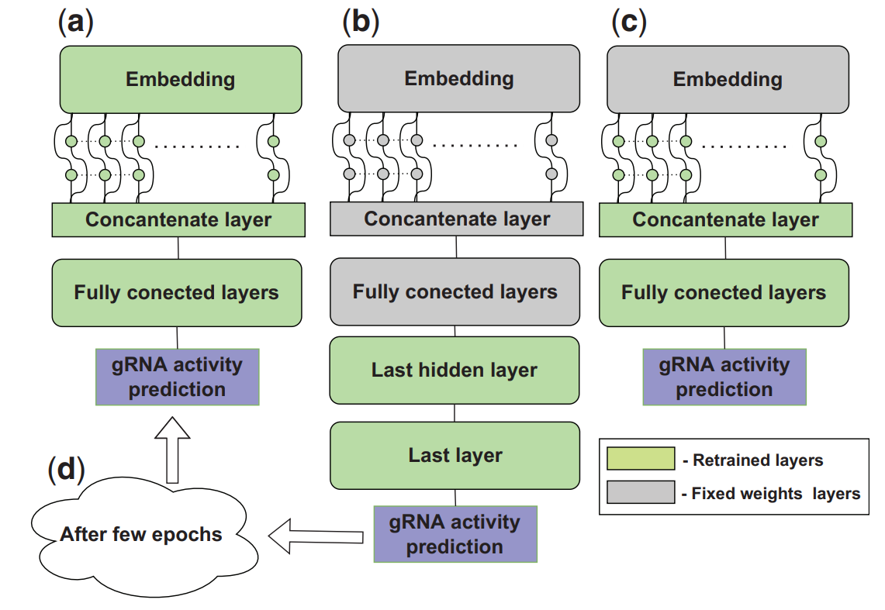
Training - Target Fine-Tuning (Cont.)
Fig. 3. The TL approaches we compared in this study. (a) The full approach finetunes all model weights. (b) The last-layer approach fine-tunes only the weights of the last hidden layer and the output layer. (c) The no-embedding approach finetunes all models weights except for the weights of the embedding layer. (d) The gradual-learning approach first fine-tunes only the weights of the last hidden layer and the output layer and then continues to fine-tune all model weights with a smaller learning rate.

Slide 16
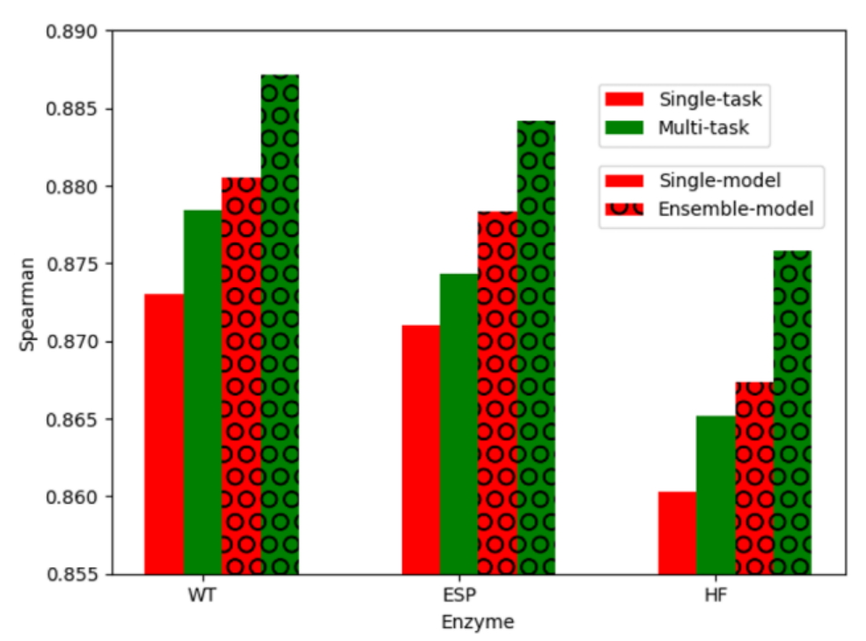
Results - Ensemble Effects
Fig. 4. Prediction performance of our newly improved DeepHF model over the three high-throughput datasets (WT, Esp and HF). Four model variants are compared: single-task for one enzyme, multi-task for all enzymes, and with and without the random initialization ensemble technique

Slide 17
Results - Evaluate Transfer Learning
The authors removed the gRNAs that were present in either the DeepHF or the CRISPROn datasets in all of the test sets, except for the three doench datasets. In those they removed only what overlapped with the DeepHF dataset. This is because all three doench datasets had more than 80% overlap with the CRISPROn dataset.
Gradual learning performed best, and the DeepHF pre-trained model outperformed the CRISPEROn pre-trained model.
The model performed notably worse with less robustness for all transfer learning approaches on the T7 promoter datasets. The authors speculated that it was due to the small size of the datasets.

Slide 18
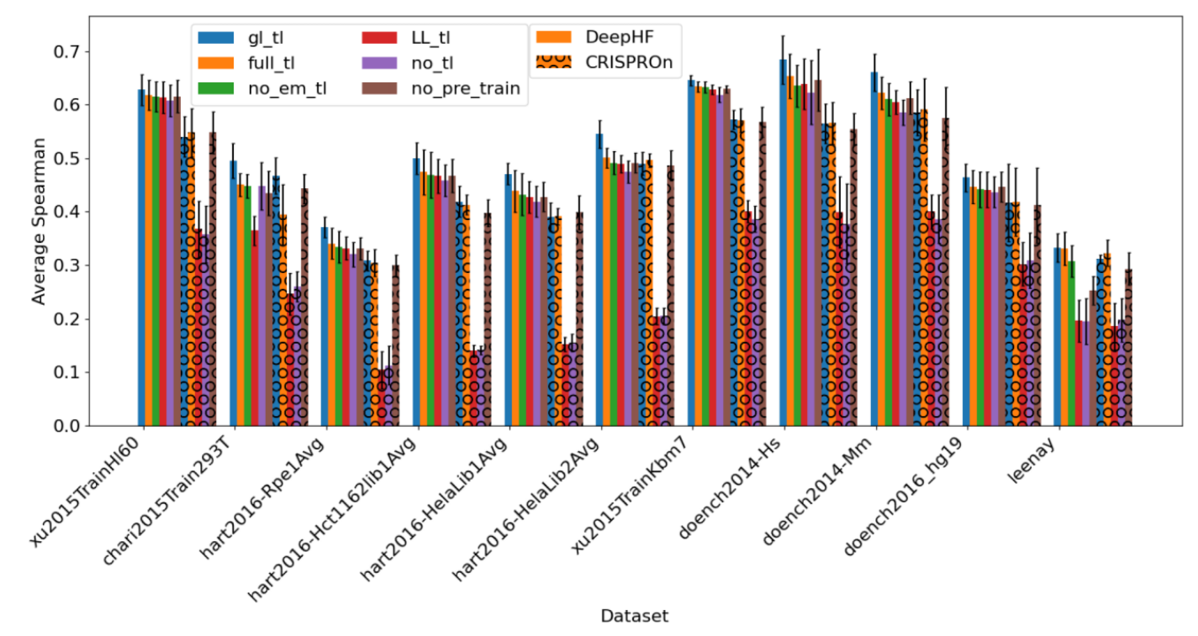
Results - Evaluate Transfer Learning (Cont.)
Fig. 5. Comparison of various TL approaches in predicting endogenous and functional on-target efficiencies. Prediction performance was gauged by average Spearman correlation of predicted and measured on-target efficiencies over five randomly held-out test sets of 20% of the data. Both DeepHF and CRISPROn architectures were used for the TL approaches comparison. DeepHF pre-train model was our newly improved DeepHF model. CRISPROn pre-train model was pre-trained on the CRISPROn dataset. Tl: transfer learning; gl: gradual learning; em: embedding; LL: last layer

Slide 19
Results - Compare to SOA
Again, the 80/20 train/test random split was performed.. The average of the five runs was reported.
DeepCRISTL significantly outperformed all of the other models it was compared to except in 2 cases (xu2015 sets), where it was on-par with the reported Wang score. The authors noted that the Wang scores were trained on the relevant datasets, which makes the comparison between them “less fair”.
The authors don’t comment on the chari2015 and leenay sets, where CRISPEROn has comparable results.

Slide 20
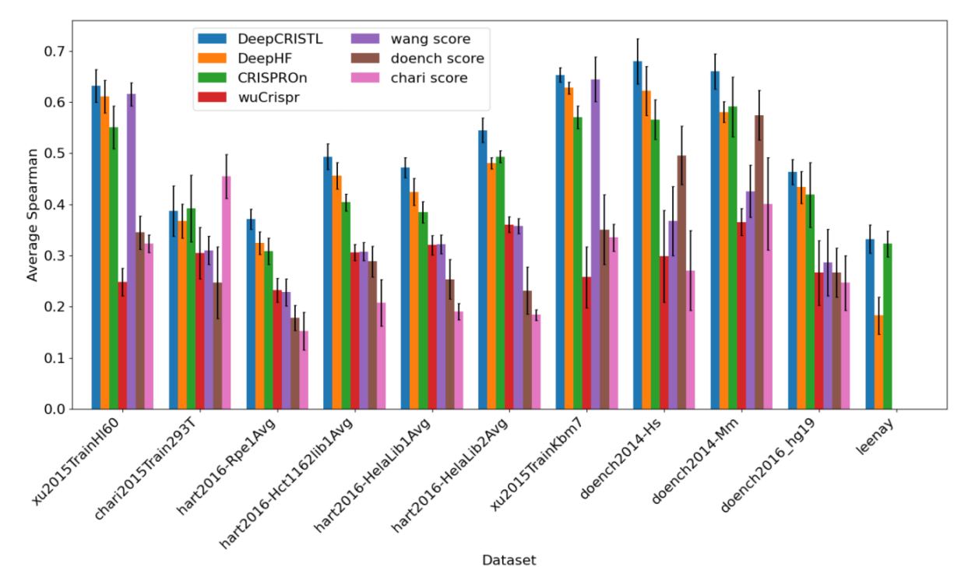
Results - Compare to SOA (Cont.)
Fig. 6. Comparison of DeepCRISTL and state-of-the-art methods in predicting endogenous and functional on-target efficiencies. The average Spearman correlation over five held-out test sets is reported for each dataset

Slide 21
References
Elkayam, S., & Orenstein, Y. (2022). DeepCRISTL: deep transfer learning to predict CRISPR/Cas9 functional and endogenous on-target editing efficiency. Bioinformatics, 38(Supplement_1), i161-i168.
Addgene: CRISPR Guide
Complete Guide To Bidirectional LSTM (With Python Codes) (analyticsindiamag.com)
CRISPR - Wikipedia
Lentiviral vector in gene therapy - Wikipedia
Quantum transfer learning — PennyLane documentation
Questions and Answers about CRISPR | Broad Institute
Recurrent Neural Networks (RNNs). Implementing an RNN from scratch in… | by Javaid Nabi | Towards Data Science

